Slide 1


OSDP User Experience Hackathon Challenge
Challenge : What is the impact of groundfish fishing on the distribution and health of Atlantic coral and sponge populations ?

Slide 2
Who Am I?
Michelle Boutilier
Information Technology Programming Analyst Student
Member of Women in Cyber Security
Owner of Krawler Konceptz, a Graphic Design company

Slide 3

Why Use the OSDP to: Explore the Effects of Fishing on Atlantic Coral?
Accessibility: The OSDP provides access to large volumes of data making it a valuable resource for research and analysis.
Open Science Data Platform (canada.ca)

Slide 4

Purpose:
Utilize these datasets to provide an analysis of changes in coral, illustrating the impact of fishing in the Atlantic.
This will aid in understanding of using ODSP Data Sets and help in updates for the User Experience of the ODSP website.

Slide 5

Key Questions
How effective is the Lophelia Coral Conservation Area in protecting coral and sponge diversity and abundance?
What is the spatial relationship between groundfish fishing activity and the distribution of sensitive benthic species like corals and sponges?

Slide 6

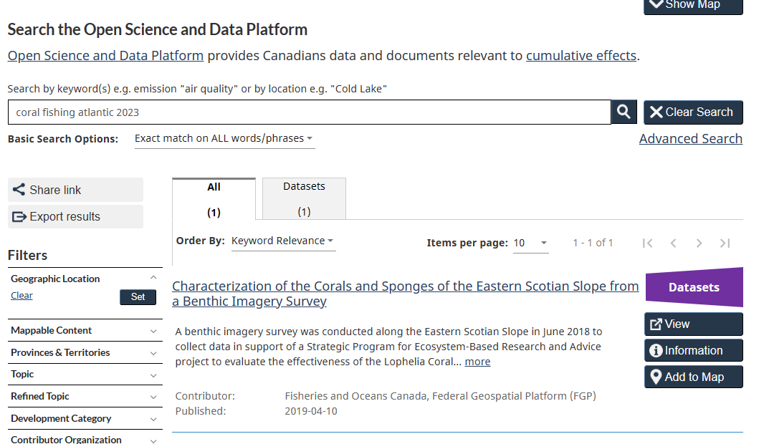
Specific Dataset to Explore:

Slide 7
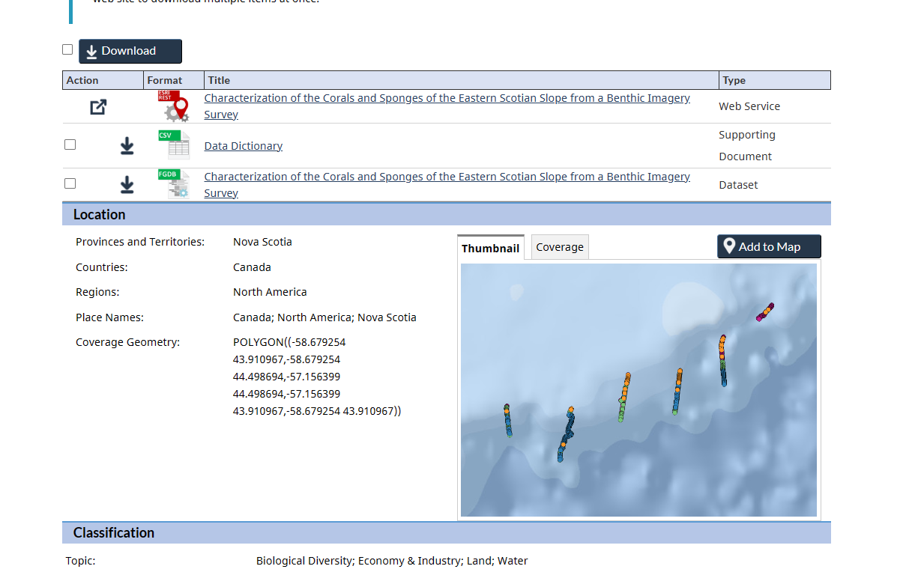
Characterization of the Corals and Sponges of the Eastern Scotian Slope from a Benthic Imagery Survey

Slide 8
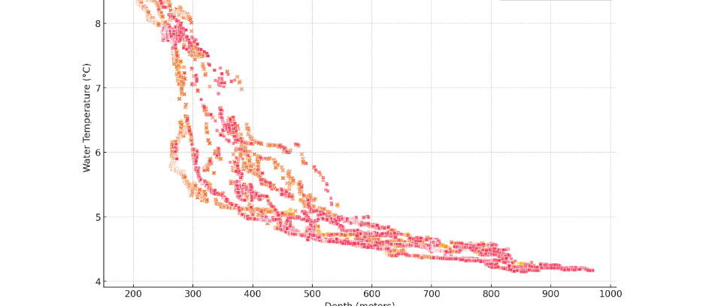
Analyzing the Trends
methods used in the analysis, I used AI Chatgpt4, that used GeoSpatial Mapping, Grouping Data, Overlay Techniques, Hypothetical Data Handling

Slide 9
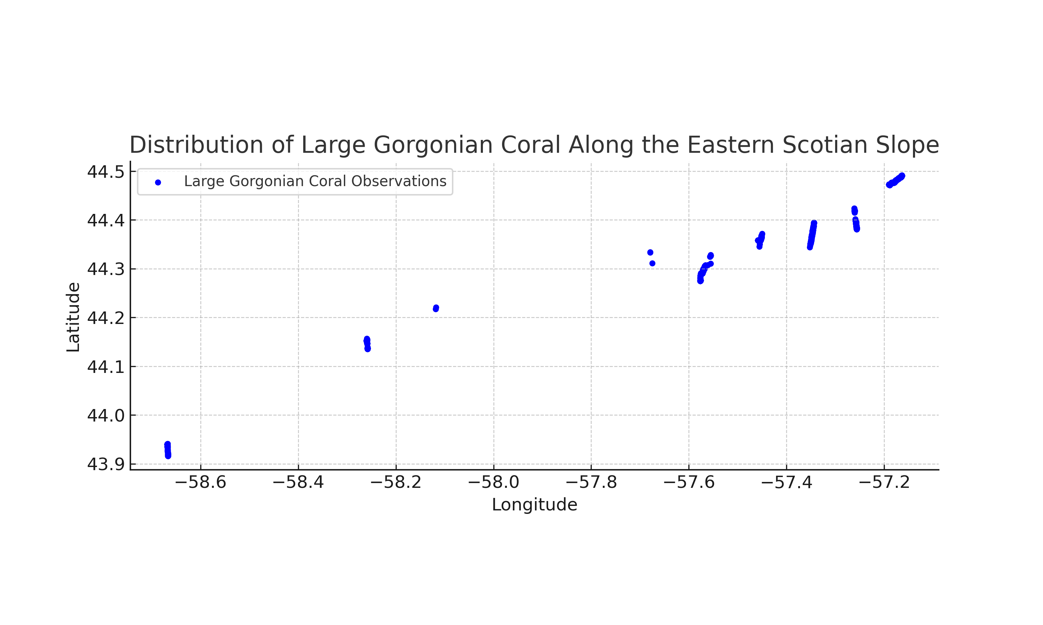
Dataset - Graph Generated by AI “ChatGPT-4”

Slide 10
Analysis of Coral and Sponge Populations
Biodiversity is higher within the conservation area, suggesting its effectiveness in protecting marine life.
Overlap between high fishing activity areas and sensitive benthic regions may lead to degradation of habitats.
Recommendations include extending conservation areas and implementing stricter fishing regulations in sensitive zones.

Slide 11
Recommendations for OSDP UX Improvement
Enhancing the user experience of the OSDP to better support research and data exploration.

Slide 12
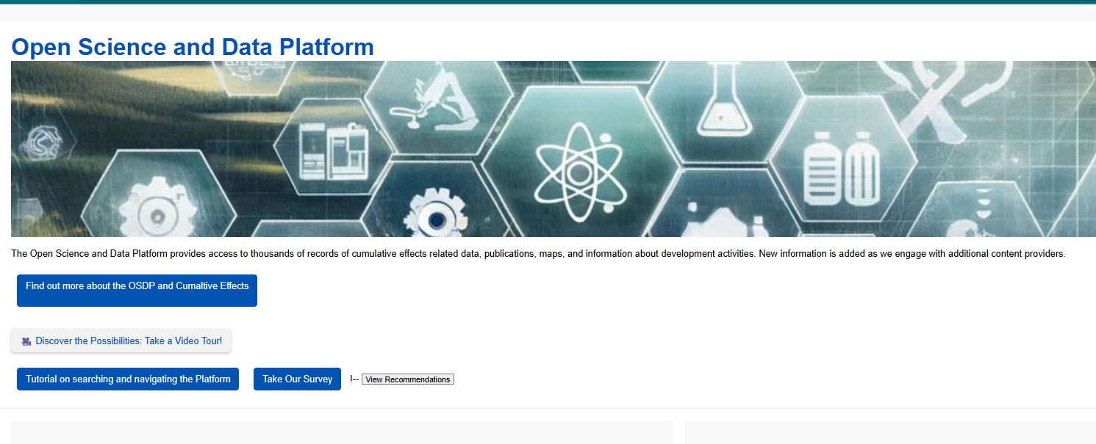
Improved Data Accessibility and Discoverability
User-friendly Interface:
The interface includes large, clear fonts and high-contrast colors for better readability, alongside simple and intuitive navigation elements.
Accessibility features are highlighted through various icons, ensuring the system is user-friendly for all, including those with disabilities.

Slide 13
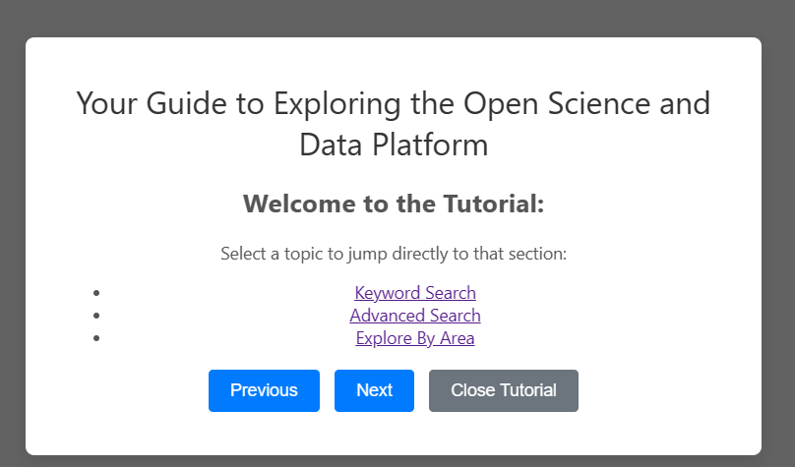
User-Centric Documentation and Support
Provide comprehensive documentation, tutorials, and a support system including a helpdesk and user forums.
Benefit: Enhances user confidence and ability to effectively utilize the platform.

Slide 14

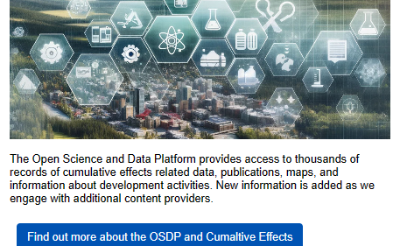
Mobile Optimization and Responsive Design
Optimize the OSDP for various devices, including mobile optimization.
Benefit: Increases accessibility and convenience for on-the-go research.

Slide 15
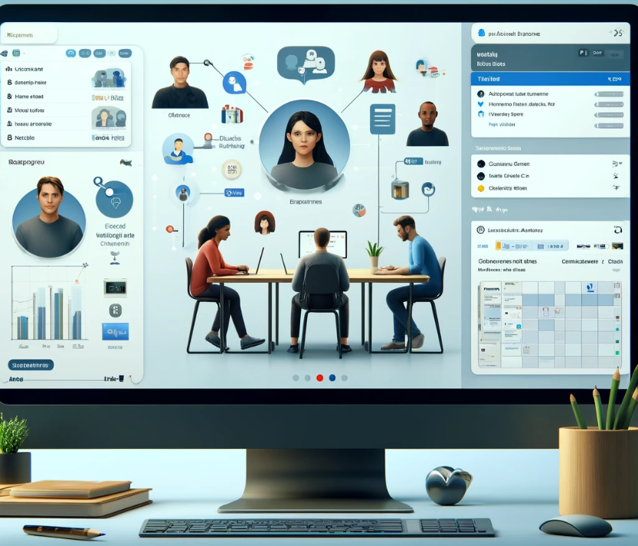
Collaboration Tools
Integrate collaboration tools like shared workspaces and communication features.
Benefit: Promotes collaborative research and facilitates data sharing.

Slide 16
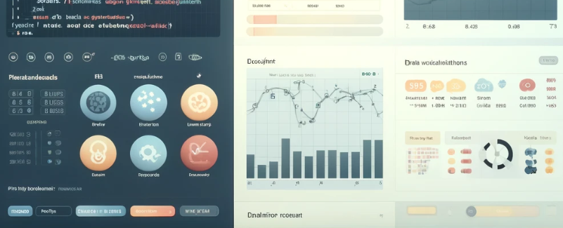
Integrated Data Analysis Tools
Incorporate built-in tools for data analysis directly within the OSDP interface, such as statistical tools, GIS capabilities, and script execution.
Benefit: Streamlines workflows and makes data analysis more accessible.
Visualization of the modern web interface design On the left, a code editor for writing and executing Python scripts, similar to a Jupyter Notebook interface; on the right, a graphical output area displaying charts and data visualization results.

Slide 17
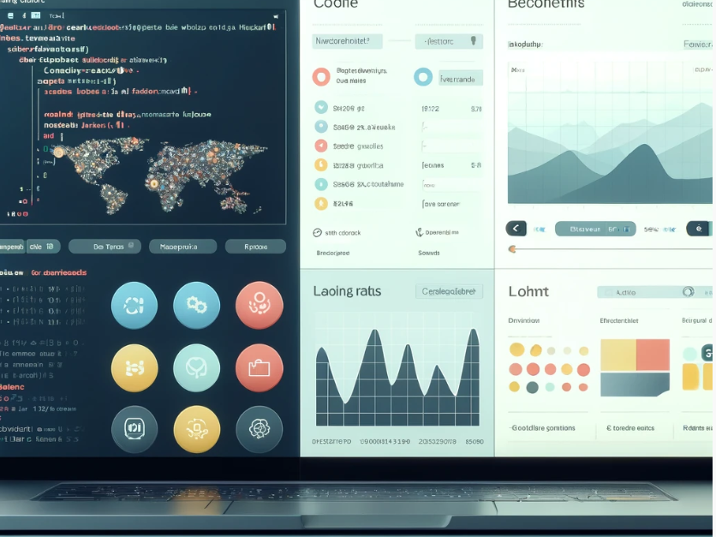
Enhanced Data Visualization Features
Include advanced mapping tools, interactive graphs, and customizable dashboards within the OSDP.
Benefit: Enables complex data visualizations directly on the platform.

Slide 18

"A Strategic Plan for Enhancing OSDP: Integrating Advanced Functionalities for Cumulative Effects Research
"Enhancing the OSDP development strategy will need to involve a mix of internal teams and external collaborations with data platform specialists. This effort will not only expand functionalities but also enhance user engagement and platform robustness.
Key Initiatives Include:
Robust Development: Leveraging both in-house and external expertise to introduce advanced tools and features.
Secured Funding and Strategic Planning: Ensuring financial and strategic resources are in place for phased implementation, maintaining both stability and security.
Continuous Improvement: Establishing ongoing feedback mechanisms with users to refine functionalities and adapt to the research community's evolving needs."

Slide 19
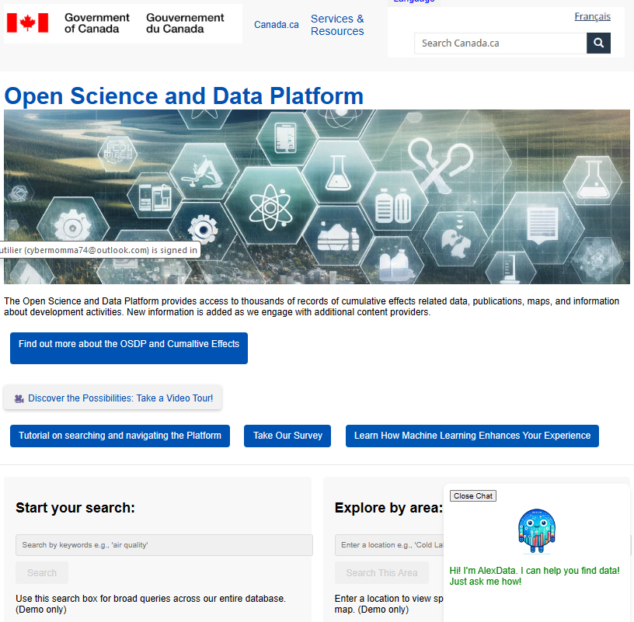

Demo: Mock Website and Logo

